Slide 1


SMART DOORBELL SYSTEM
Kabir Varsha - 1602-16-737-055
Devi Kadampalli - 1602-16-737-311

Slide 2

PROBLEM STATEMENT - USER PROFILE
• In a busy world where people often get busy ,it is difficult for the 59% employed people to remember schedules outside their profession.
• Many a times people misplace their keys and if you're to choose between time and security, you know both are important .
• If you are out and someone from your family/friends needs the key but you remember it's with you and so they have to wait until you return.

Slide 3
PROBLEM STATEMENT – ISSUES IDENTIFICATION
Targeted for security and convenience of people who are absorbed with work life.
Helps in attending guests who come all the way to visit people.
Notifies the person even when he/she is at any part of the world.

Slide 4
OBJECTIVES – USE CASES OR STORIES
The following are 3 use cases that are being implemented,
Human Presence Sensing:
Whenever a human activity is detected , the doorbell will switch on automatically and alert the residents regarding it.
2. Notifying The User:
It can send a notification to a user at any part of the world via SMS or email.

Slide 5

HIGH LEVEL DESIGN
PIR sensors for detecting human activity.
Cloud for storage and analysis of received data.
Arduino IDE software for writing and uploading the programming logic into the Arduino Uno board.
Piezo buzzer for generating sound.

Slide 6
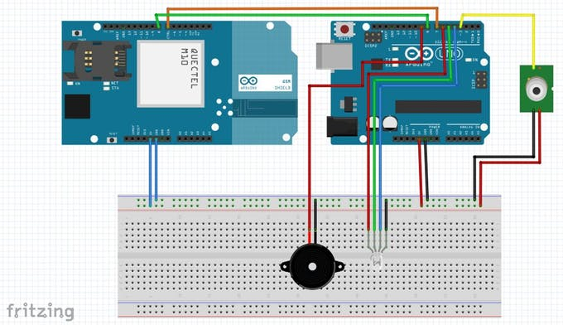
Circuit Diagram

Slide 7
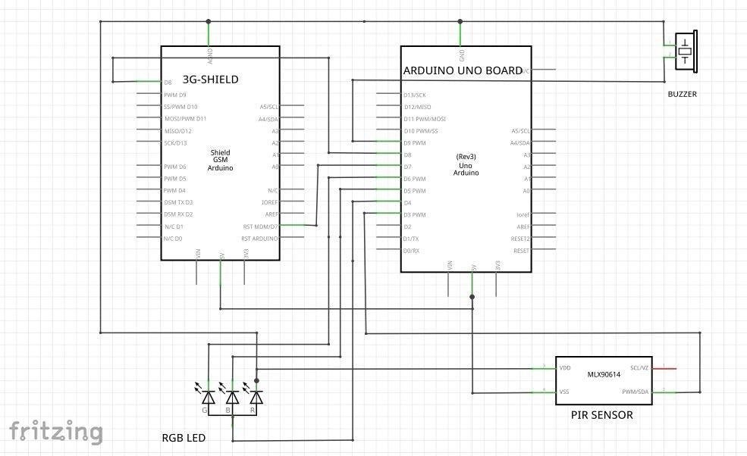
UML Diagram

Slide 8
THANK YOU

